Slide 1



LOOK BACK 4
Part 2

Slide 2
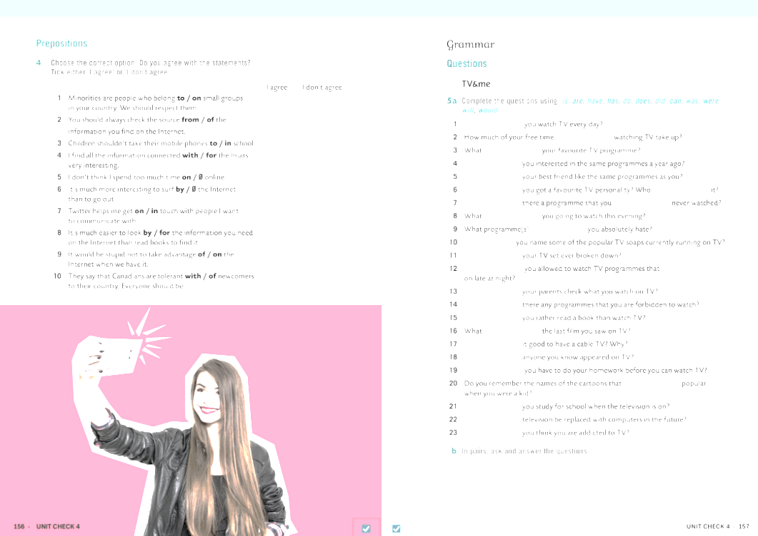
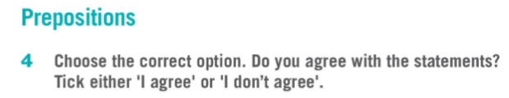
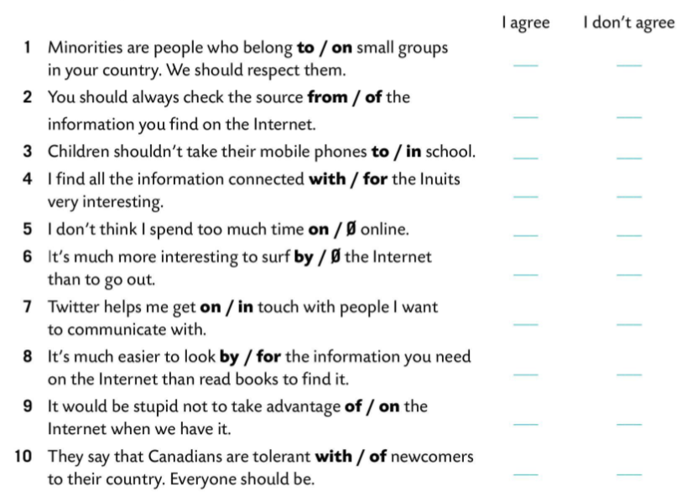

Slide 3
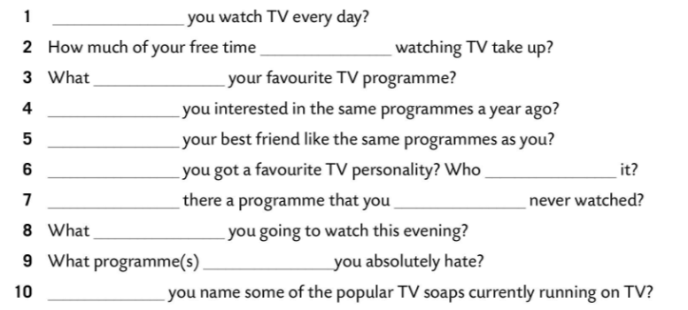

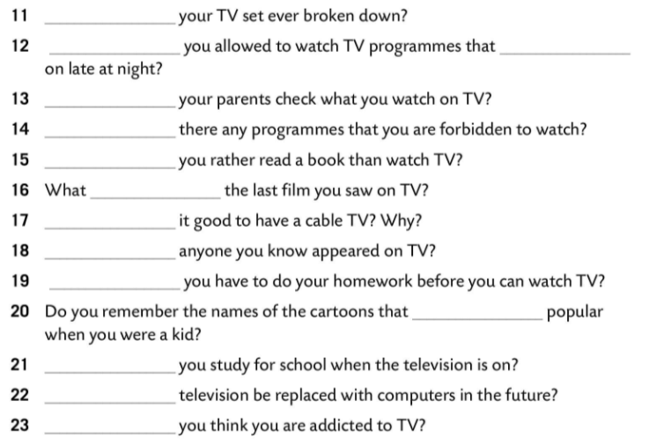


Do
does
is
Were
Does
Have
is
Is
have
are
Has
do
Are
are
Can
Do
Are
Do
was
Is
Has
Do
were
Can
Will
Do

Slide 4
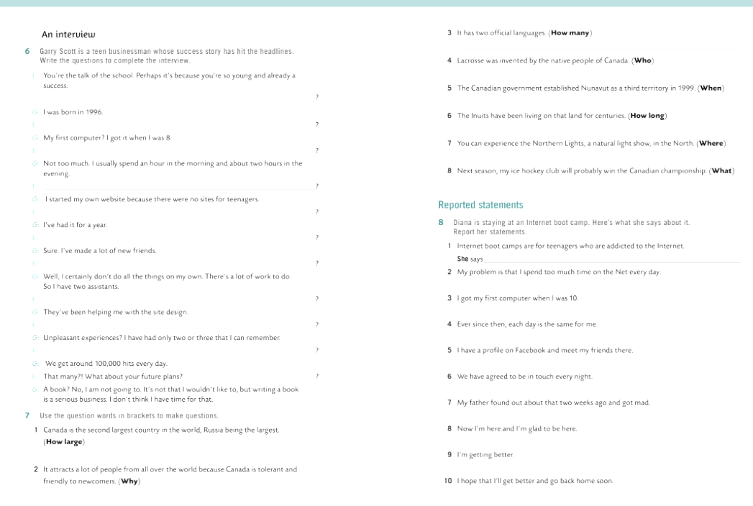
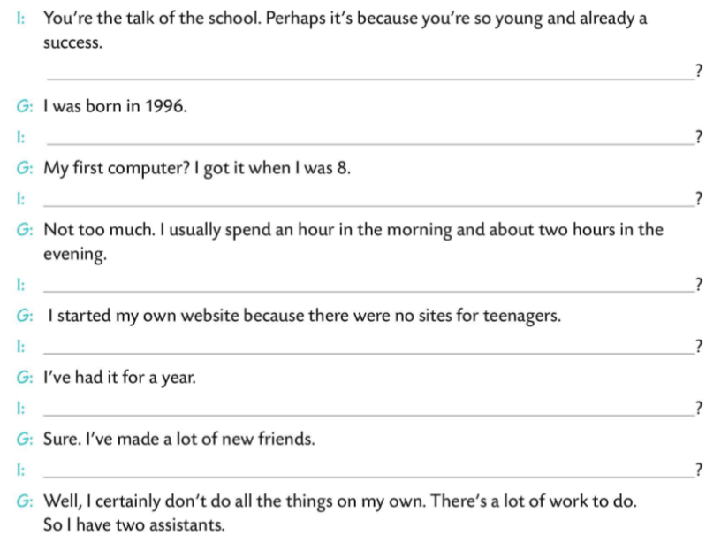
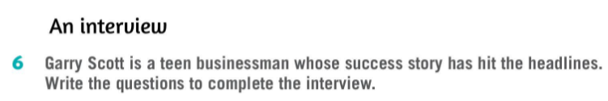
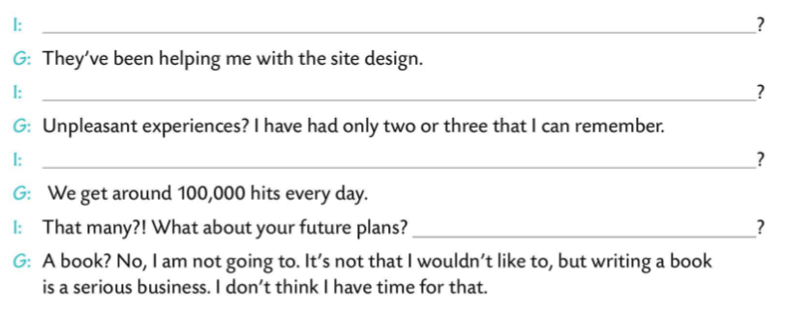
When were you born?
When did you get your first computer?
How much time do you spend on your computer every day?
Why did you start your website?
How long have you had it?
Have you made many friends?
Does anyone help you?
What do they do?/ What have they been doing?
Have you had any unpleasant experiences?
How many hits do you get every day?
Will you write a book?

Slide 5
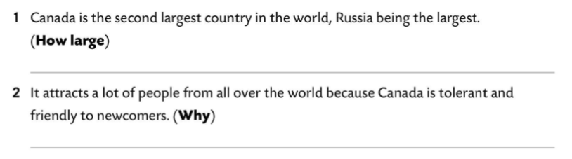
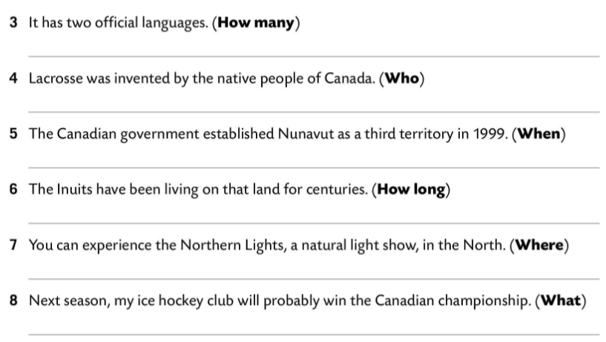
How large is Canada?
Why does it attract many people from all over the world?
How many official languages does it have?
Who was lacrosse invented by?
When did the Canadian government establish Nunavut as the third territory?
How long have the Inuits been living on that land?
Where can you experience the Northern Lights?
What will your ice hockey club probably win next season?

Slide 6
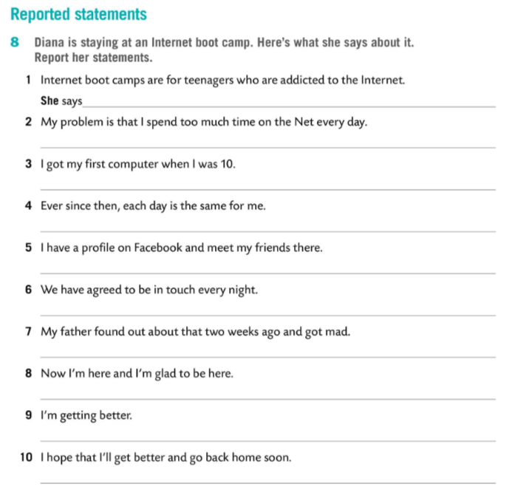
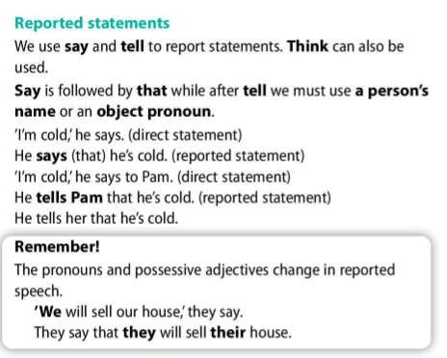

that Internet boot camps are for teenagers who are addicted to the Internet.
She says that her problem is that she spends too much time on the Net every day.
She says that she got her first computer when she was 10.
She says that ever since then each day is the same for her.
She says that she has a profile on Facebook and meets her friends there.
She says that they have agreed to be in touch every night.
She says that her father found out about that two weeks ago and got mad.
She says that now she is here and she is glad to be here.
She says that she is getting better.
She says that she hopes she will get cured and go back home soon.

Slide 7
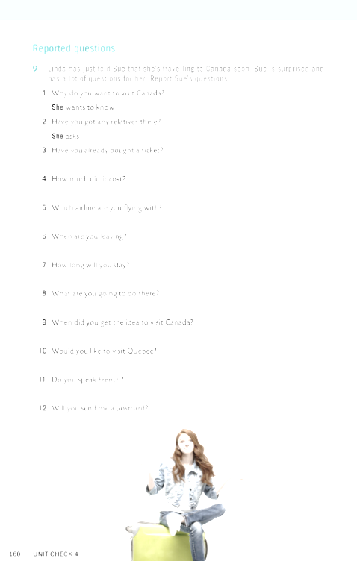
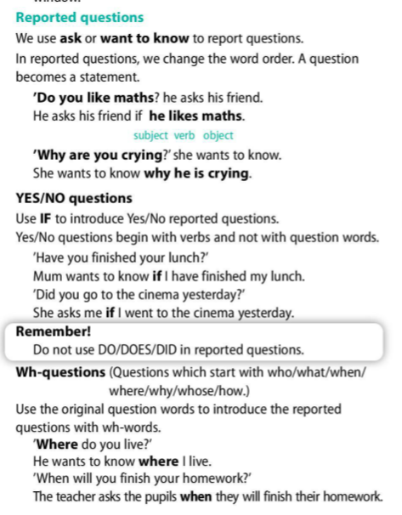
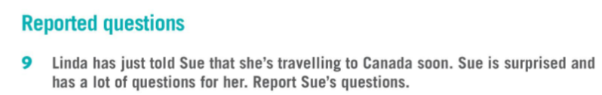
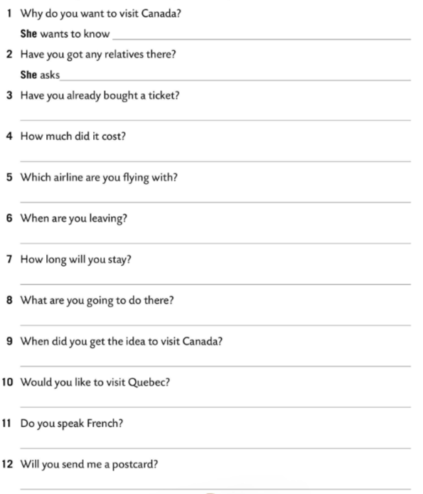
why Linda wants to visit Canada.
if Linda has got any relatives there.
She asks if Linda has already bought a ticket.
She wants to know how much it cost.
She asks which airline Linda is flying with.
She asks when Linda is leaving.
She asks how long Linda will stay.
She asks if Linda would like to visit Quebec.
She asks what Linda is going to do there.
She wants to know if Linda speaks French.
She wants to know when Linda got the idea to visit Canada.
She asks if Linda will send her a postcard.

